Slide 1
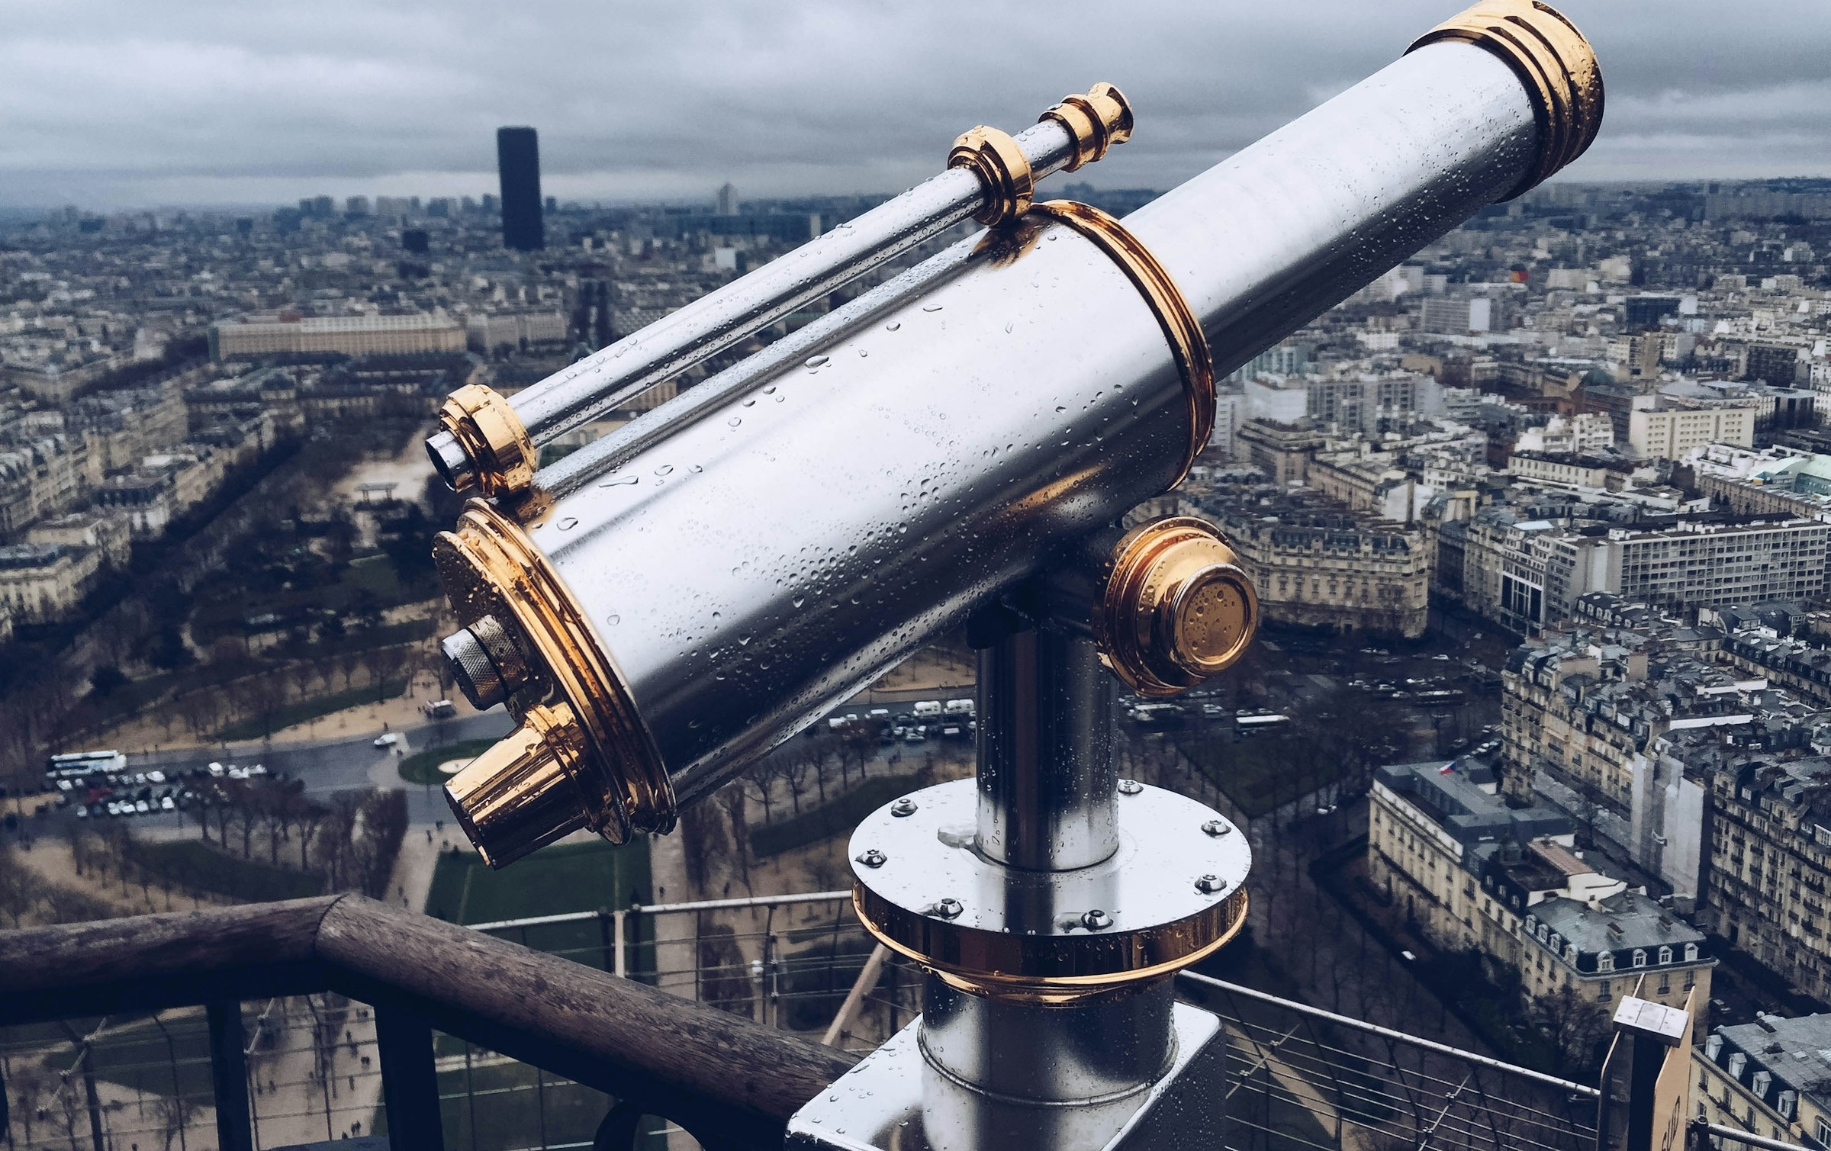
Multimodal Approaches for Search and Discovery of Archival Collections
Prof. Taylor ARNOLD
University of Richmond
Approches Linguistiques Théoriques, Appliquées et Expérimentales : langues et cultures connectées
Université Paris Cité
Salle 720
Paris, France
27 January 2025, 14h00 > 15h00
https://distantviewing.org

Slide 2

1. Introduction
01 – Distant Viewing | Introduction

Slide 3
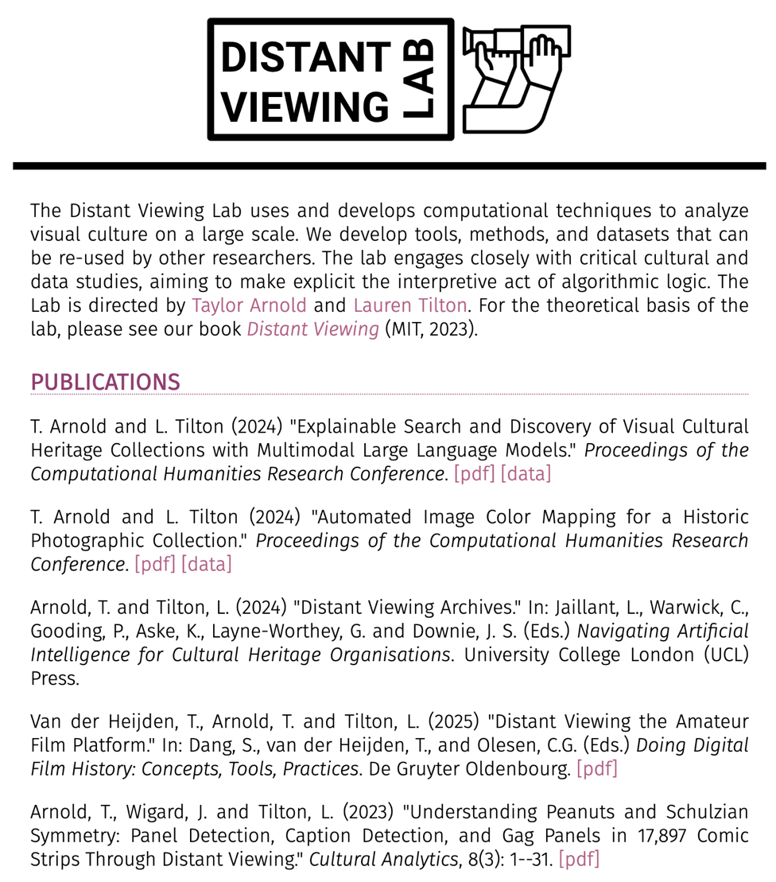

Distant Viewing Lab
The Distant Viewing Lab uses and develops computational techniques to analyze visual culture on a large scale.
We develop tools, methods, and datasets that can be re-used by other researchers. The lab engages closely with critical cultural and data studies, aiming to make explicit the interpretive act of algorithmic logic.
https://distantviewing.org
Generously supported through funding from:
01 – Distant Viewing | Introduction

Slide 4
2. DOCUMERICA
02 – Distant Viewing | DOCUMERICA

Slide 5
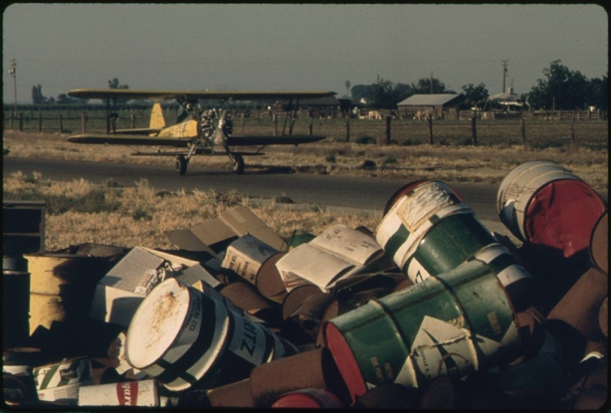
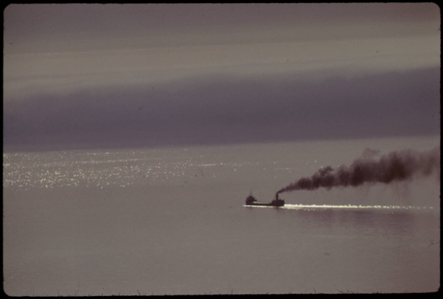
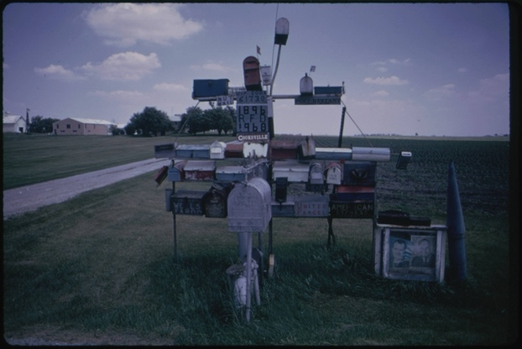
DOCUMERICA
From 1972 to 1978 the U.S. Environmental Protection Agency (EPA) sponsored the DOCUMERICA photography project to document contemporary environment issues and highlight ongoing work by the agency.
Gene Daniels, Discarded Pesticide Cans (May 1972).
Donald Emmerich, Ore Carrier Heads into Lake Superior (June 1973).
Arthur Greenberg, Excentric Mailbox Display (June 1973).
02 – Distant Viewing | DOCUMERICA

Slide 6
DOCUMERICA
From 1972 to 1978 the U.S. Environmental Protection Agency (EPA) sponsored the DOCUMERICA photography project to document contemporary environment issues and highlight ongoing work by the agency.
The U.S. National Archives and Records Administration (NARA) has digitized and made available nearly 16,000 images taken by the DOCUMERICA photographers.
Gene Daniels, Discarded Pesticide Cans (May 1972).
Donald Emmerich, Ore Carrier Heads into Lake Superior (June 1973).
Arthur Greenberg, Excentric Mailbox Display (June 1973).
02 – Distant Viewing | DOCUMERICA

Slide 7
DOCUMERICA
From 1972 to 1978 the U.S. Environmental Protection Agency (EPA) sponsored the DOCUMERICA photography project to document contemporary environment issues and highlight ongoing work by the agency.
The U.S. National Archives and Records Administration (NARA) has digitized and made available nearly 16,000 images taken by the DOCUMERICA photographers.
Public interest in the collection has recently grown with the increased focus on environmental concerns. While the images are freely accessible from the NARA website and released into the public domain, the ability to understand the scope of the collection in its current form is limited.
Gene Daniels, Discarded Pesticide Cans (May 1972).
Donald Emmerich, Ore Carrier Heads into Lake Superior (June 1973).
Arthur Greenberg, Excentric Mailbox Display (June 1973).
02 – Distant Viewing | DOCUMERICA

Slide 8
DOCUMERICA
The research question that drives our work today:
How can we use computational approaches to help organize and create generous interfaces for this important photographic archive?
Gene Daniels, Discarded Pesticide Cans (May 1972).
Donald Emmerich, Ore Carrier Heads into Lake Superior (June 1973).
Arthur Greenberg, Excentric Mailbox Display (June 1973).
02 – Distant Viewing | DOCUMERICA

Slide 9
3. Theory
02 – Distant Viewing | Theory

Slide 10
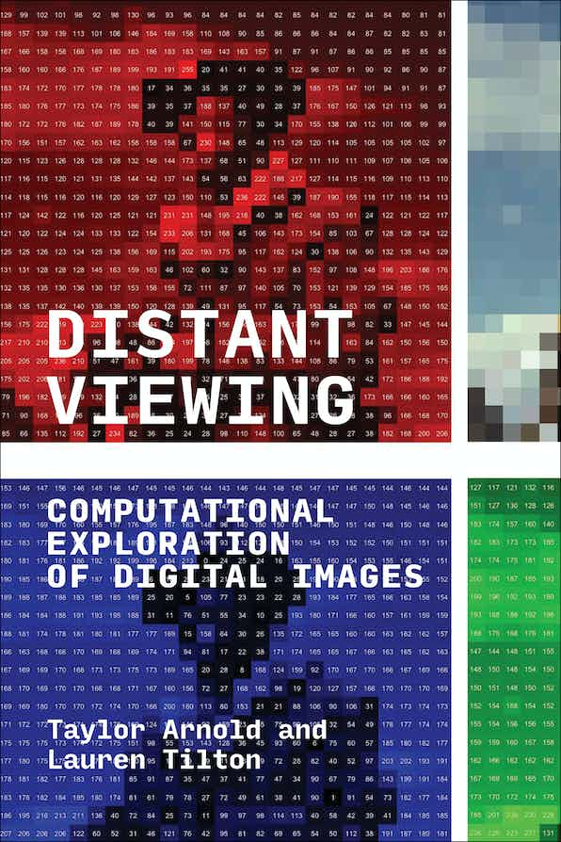
Distant Viewing Book (2023)
For more details about the theory and method of distant viewing, please check out our recently published book Distant Viewing (MIT Press, 2023). It has been released under an OA license and can be freely downloaded from the following link:
https://distantviewing.org/book
Distant Viewing: Computational Exploration of Digital Images
By Taylor Arnold, Lauren Tilton
The MIT Press
DOI: https://doi.org/10.7551/mitpress/14046.001.0001
ISBN electronic: 9780262375160
In Special Collection: CogNet
Publication date: October 2023
03 – Distant Viewing | Theory

Slide 11
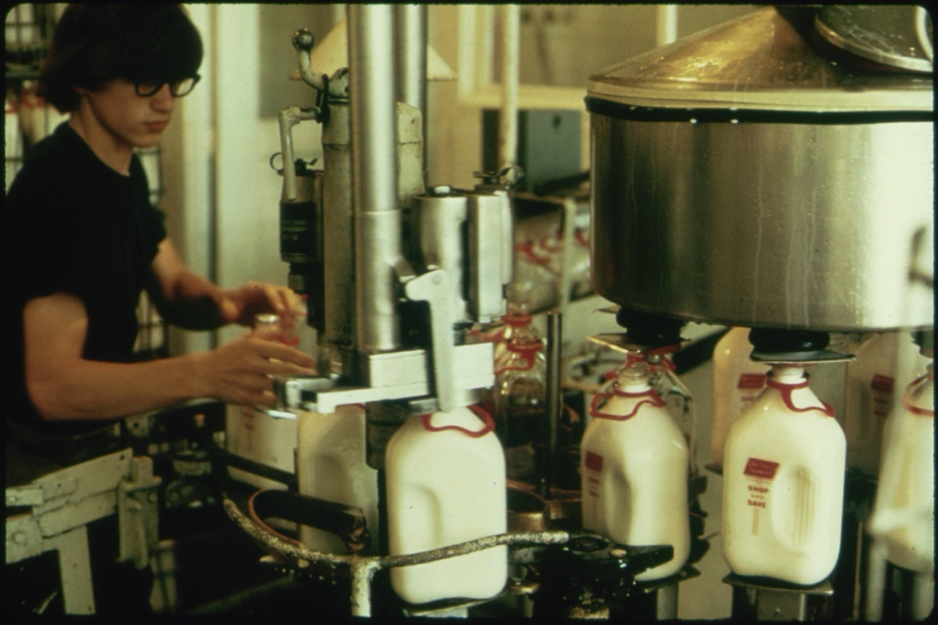
Distant Viewing Theory: Overview
Flip Schulke, Employee of the Donald Dannheim Family who operate a dairy and ice cream store (July 1974).
Distant Viewing is a theory of how the computational exploration of digital images through the application of computer vision works, and why it is needed.
starting image
03 – Distant Viewing | Theory
T. Arnold and L. Tilton, (2023) Distant Viewing, MIT Press.

Slide 12
Distant Viewing Theory: Overview
Flip Schulke, Employee of the Donald Dannheim Family who operate a dairy and ice cream store (July 1974).
Distant Viewing is a theory of how the computational exploration of digital images through the application of computer vision works, and why it is needed.
Mimetic nature of images necessitates that the computational analysis of digital images starts with the extraction of semantic metadata using computer vision.
starting image
annotations
black, brown, white
{ bottle, milk }
indoors
1 person
03 – Distant Viewing | Theory
T. Arnold and L. Tilton, (2023) Distant Viewing, MIT Press.

Slide 13
Distant Viewing Theory: Overview
Flip Schulke, Employee of the Donald Dannheim Family who operate a dairy and ice cream store (July 1974).
Distant Viewing is a theory of how the computational exploration of digital images through the application of computer vision works, and why it is needed.
Mimetic nature of images necessitates that the computational analysis of digital images starts with the extraction of semantic metadata using computer vision.
The process of constructing annotations is a computationally mediated form of “viewing”.
starting image
annotations
black, brown, white
{ bottle, milk }
indoors
1 person
03 – Distant Viewing | Theory
T. Arnold and L. Tilton, (2023) Distant Viewing, MIT Press.

Slide 14
Distant Viewing Theory: Overview
Flip Schulke, Employee of the Donald Dannheim Family who operate a dairy and ice cream store (July 1974).
Distant Viewing is a theory of how the computational exploration of digital images through the application of computer vision works, and why it is needed.
Mimetic nature of images necessitates that the computational analysis of digital images starts with the extraction of semantic metadata using computer vision.
The process of constructing annotations is a computationally mediated form of “viewing”.
The application of computer vision is not a neutral process. It engages in socially mediated ways of seeing and viewing that are encoded into the algorithms and the ways that they are used.
starting image
annotations
black, brown, white
{ bottle, milk }
indoors
1 person
03 – Distant Viewing | Theory
T. Arnold and L. Tilton, (2023) Distant Viewing, MIT Press.

Slide 15
4. Searching Visual Collections
04 – Distant Viewing | Classic Approaches

Slide 16
Searching Visual Collections: Metadata
Unlike large commercial sites, which have the volume and resources to study user behavior, public digital collections have long been restricted to the kinds of search interfaces that they can create.
For a long time, the only possibility was to build interfaces around existing metadata. This can be a powerful technique, particularly when rich metadata is already available and aligns well with the kinds of exploration and discovery that users of the collection are interested in.
The DOCUMERICA corpus includes some limited but fairly consist metadata, but most photos do include a location (at the level of a town), date (month and year), and the name of the photographer. Most images have captions; some of these are several sentences, whereas many only include a few key terms.
July 1974
Flip Schulke
New Ulm, Minnesota
04 – Distant Viewing | Classic Approaches

Slide 17
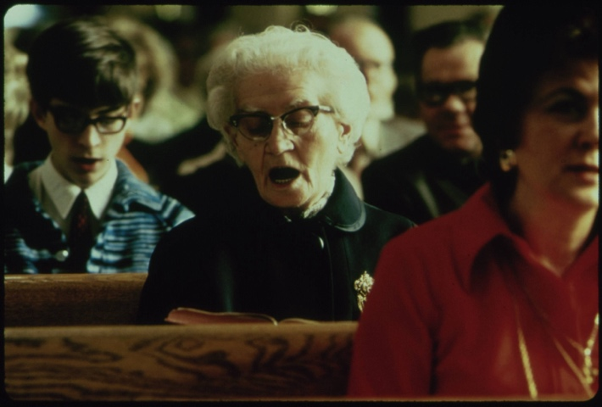
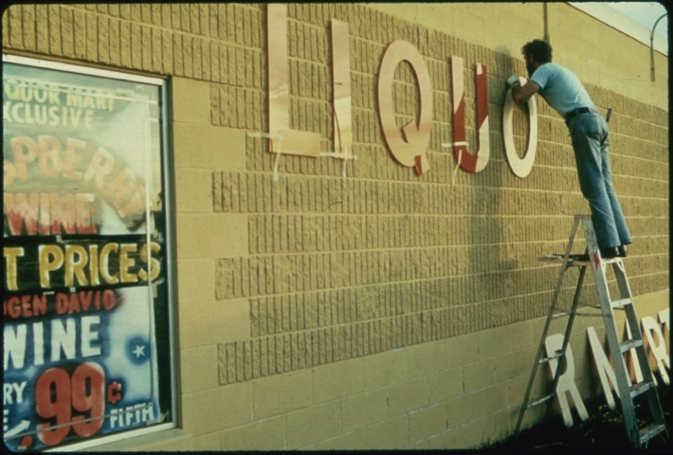
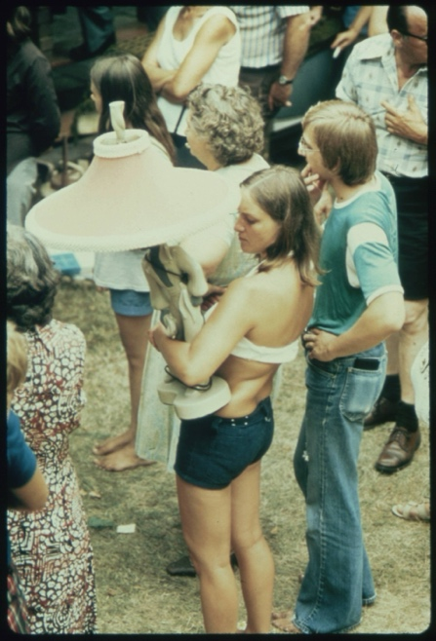
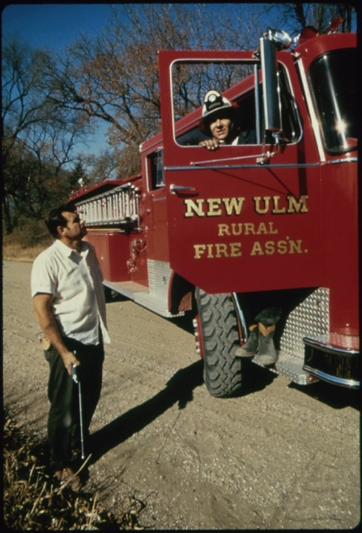
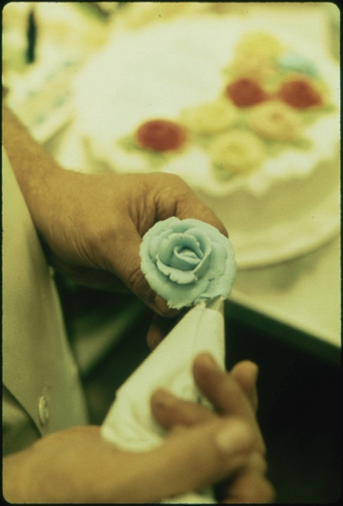
Searching Visual Collections: Metadata
For example, here are the other images that have the same photographer, location, and date as our starting image. It seems that Flip Schulke took a variety of images throughout the town of Ulm, Minnesota during his visit in July 1074.
Flip Schulke, Five Photos from Ulm, Minnesota, Documerica Project (July 1974).
04 – Distant Viewing | Classic Approaches

Slide 18
Searching Visual Collections: Metadata
Advantages
Relatively easy to integrate into a public interface.
Simple to explain, understand, and regulate.
Can be used with nearly any kind of archive.
Avoids some potential difficulties that government archives have with creating/displaying original information.
Difficulties
Can only be used with collections that have rich metadata.
Locked into the archival logic of the collection.
Metadata may be too granular or too coarse for specific applications.
Does not use the visual component of the images in a direct way.
Flip Schulke, Five Photos from Ulm, Minnesota, Documerica Project (July 1974).
04 – Distant Viewing | Classic Approaches

Slide 19
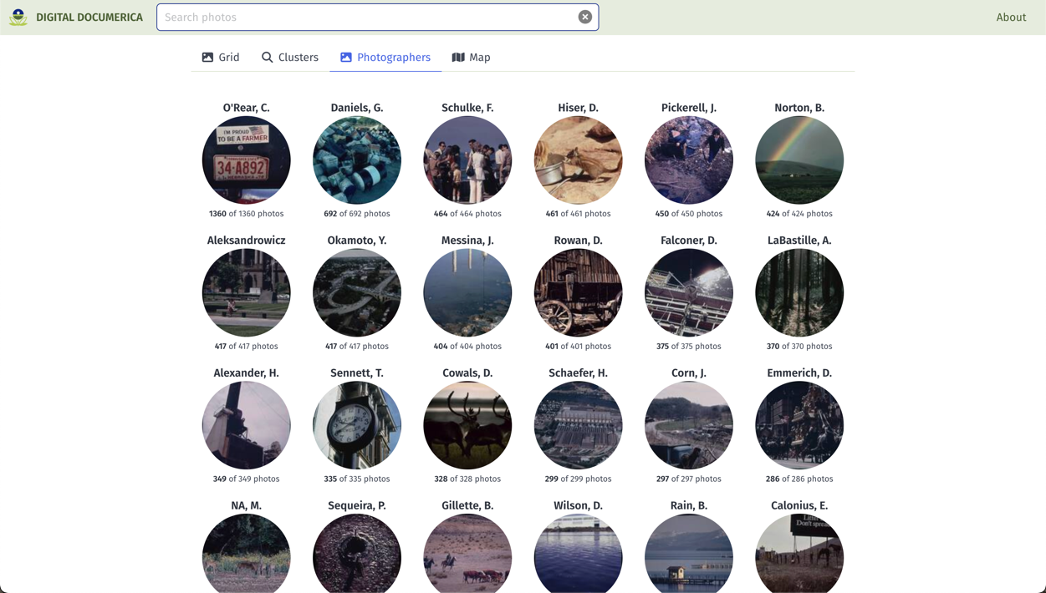
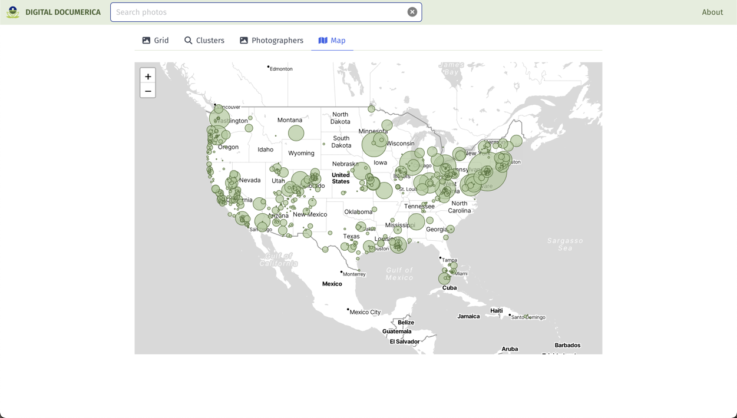
Digital Documerica
Metadata continues to be an important search and discovery tool. We have built in several faceted search and discovery methods in our interface for Documerica.
On the right are screenshots showing examples of searching the collection by photographer name (top) and the photo location (bottom).
T. Arnold, P. Leonard and L. Tilton. (2017) "Knowledge Creation Through Recommender Systems." Digital Scholarship in the Humanities, 32.3: 151-157.
04 – Distant Viewing | Classic Approaches

Slide 20
5. Multimodal AI Models
05 – Distant Viewing | MLLMs

Slide 21
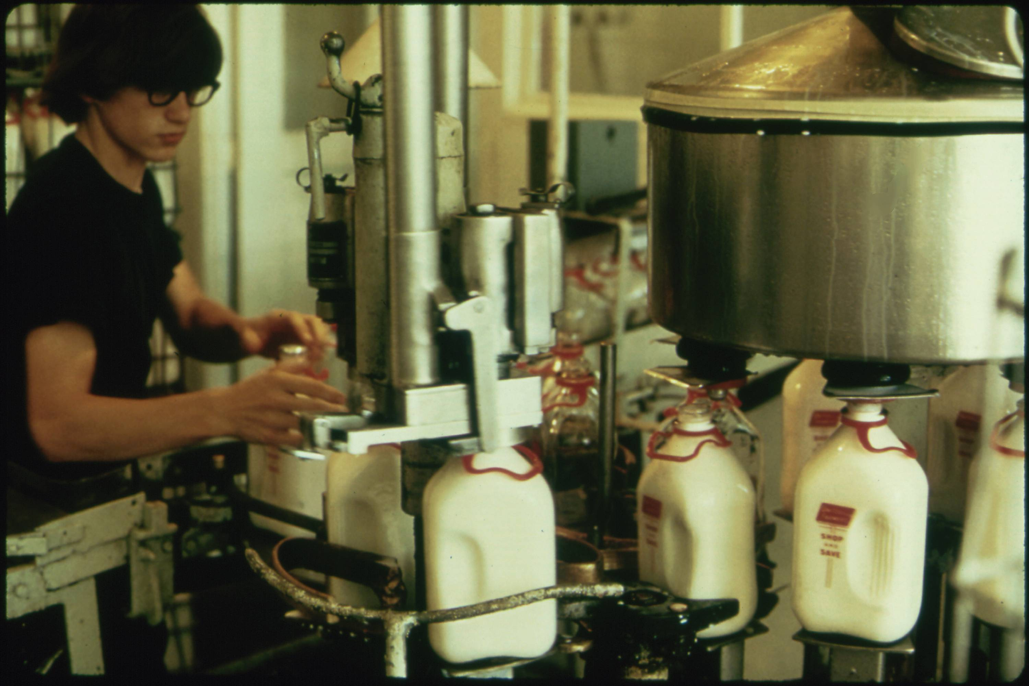
MLLM Example (GPT-4 Turbo)
Let’s take our example image from the DOCUMERICA collection to understand some of the possibilities of these models.
We selected ChatGPT’s GPT-4 Turbo model as it was the generally considered the most powerful available at the time of our project (May 2024).
We provide the image along with a prompt suggesting the information that we would like the model to return.
Prompt: Provide a detailed plain-text description of the objects, activities, people, background and/or composition of this photograph.
05 – Distant Viewing | MLLMs

Slide 22
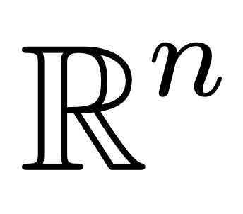
Multimodal AI Models
There are several different varieties of generative multimodal models. They can roughly be broken down into two varieties:
MLLMs
CLIP / SigLIP
+ PROMPT
“A bottle of milk”
This photograph captures a scene inside…
05 – Distant Viewing | MLLMs

Slide 23

MLLM Example (GPT-4 Turbo)
Response: This photograph captures a scene inside an industrial or agricultural processing facility, possibly a dairy. The image focuses on a female worker engaged in operating machinery used for filling milk bottles. She is wearing glasses and a black top, and appears to be adjusting or handling the bottles or the machine. The worker is surrounded by a complex arrangement of stainless steel machinery and equipment. On the right side of the frame, there's a large metal vat or container, possibly holding milk or another liquid, with its lid partially visible. In the foreground, we see a series of white plastic milk bottles, each adorned with a red label. These bottles are lined up on a conveyor belt or a filling station, which seems to be part of a mechanized assembly line designed for packaging. The machinery includes various knobs, valves, metal structures, and hoses participating in the bottling process. The interior setting is lit with what appears to be fluorescent lighting, adding a utilitarian ambience to the workspace. The overall scene conveys a moment of daily operations wherein the worker is focused on ensuring the efficiency and correctness of the bottling process.
Prompt: Provide a detailed plain-text description of the objects, activities, people, background and/or composition of this photograph.
05 – Distant Viewing | MLLMs

Slide 24
SigLIP Example (GPT-4 Turbo)
“Glass bottles” => 2.66
“Milk” => 11.55
“Bottle filling factory” => 18.39
“Milk bottles in a factory” => 32.15
“A man filling bottles of milk” => 98.57
05 – Distant Viewing | MLLMs

Slide 25
6. New Possibilities
06 – Distant Viewing | New Approach

Slide 26
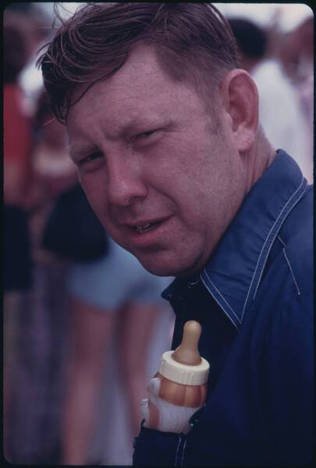

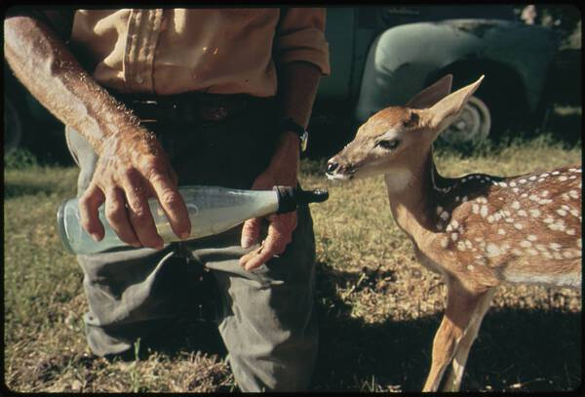
Using MLLMs For Search and Discovery
MLLMs provide a new approach to opening digital visual archives for increased search and discovery. We can create annotations by passing pairs of images and prompts together and storing the output.
We can then allow users to search the contents of the collection against terms found anywhere in any of the captions.
On the right are the three images that match the query “milk bottle”
06 – Distant Viewing | New Approach

Slide 27
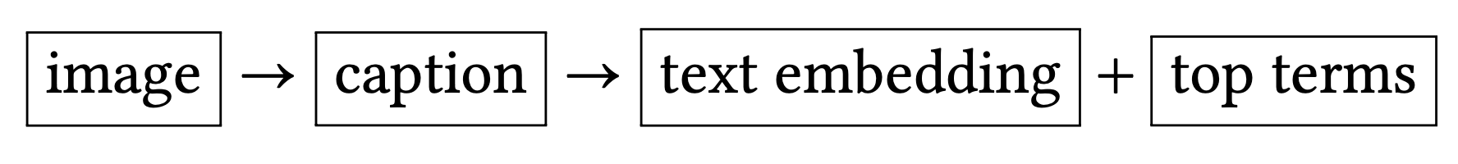
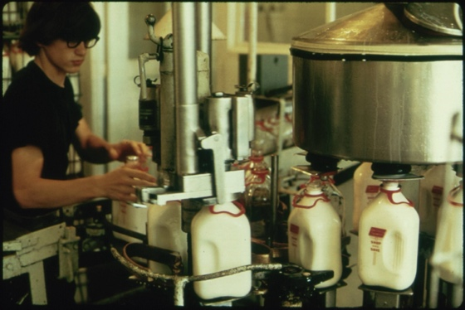
Using MLLMs For Search and Discovery
MLLMs provide a new approach to opening digital visual archives for increased search and discovery. We can create annotations by passing pairs of images and prompts together and storing the output.
The output can then by converted into text-based embeddings (created and used similarly to image embeddings) as well as top terms (using something such as TF-IDF and used like tags from archival metadata or supervised learning).
107, 230, 13, 85, 124, 65, 191, 221, 150, 6, 223, 242, 11, ….
text embedding
{ dairy, milk, glasses, machinery, worker, machinery }
image
top-terms
This photograph captures a scene inside an industrial dairy. The image focuses on a female worker engaged in operating machinery used for filling milk bottles….
caption
06 – Distant Viewing | New Approach

Slide 28
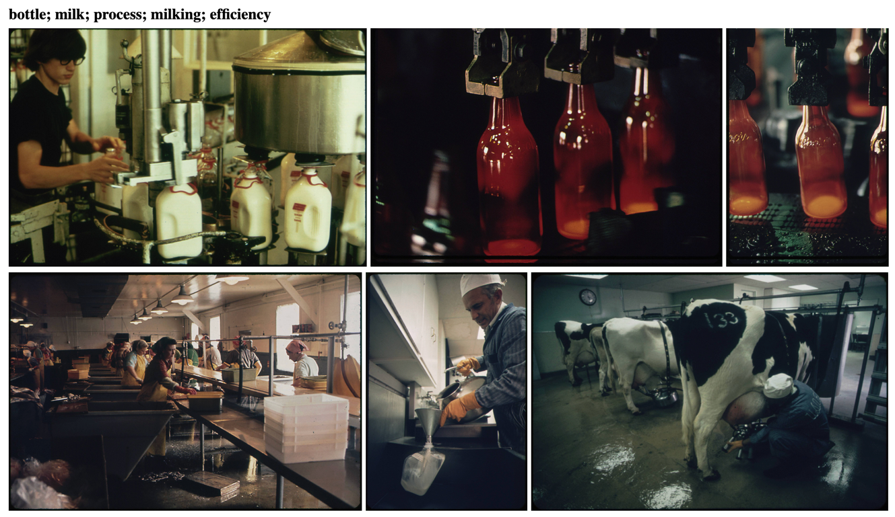
MLLMs For Search + Discovery
Advantages
Can be used on any collection without the need for existing metadata.
The automatic captions can be used as both search and recommendation system.
Able to explain the connections between images.
Filter/edit the text to try to avoid certain kinds of connections.
Open the captions for inquiry or hide them to avoid exposing false-inferences.
Works on a variety of inputs, including art works and printed materials.
Continued Questions and Challenges
Questions about biases in the data (often not public).
Determining good prompts and models to use for specific applications.
Cost associated with non-public APIs or need to acquire large computing resources for public models.
06 – Distant Viewing | New Approach

Slide 29
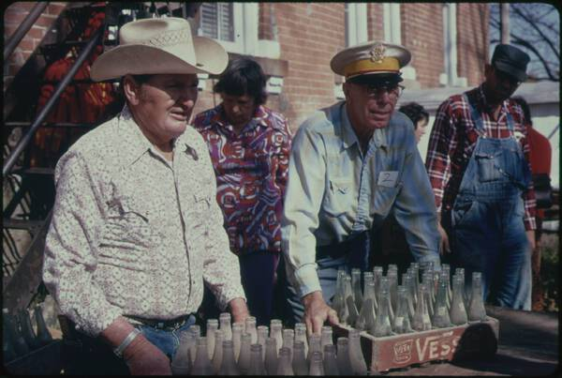
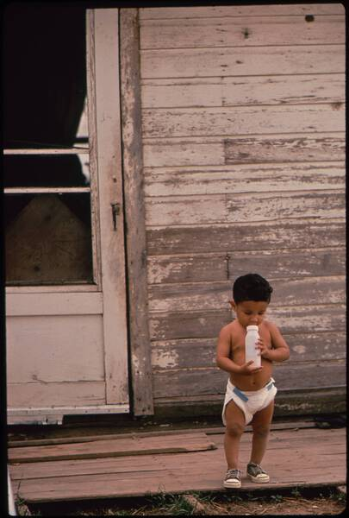
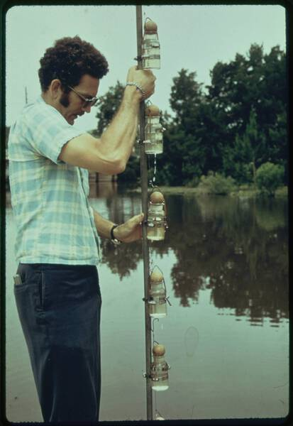
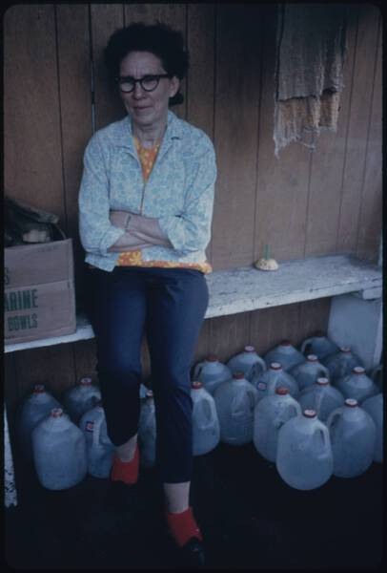
Using SigLIP For Search and Discovery
Models such as SigLIP also offer an approach to search and discovery of visual image. We can allow users to write a search query, apply the embedding, and then display images from the most to the least similar.
On the right are the images that most closely match the query “milk bottle”
06 – Distant Viewing | New Approach

Slide 30
Using SigLIP For Search and Discovery
Advantages
Allows for alternative terminologies that may have a different level of specificity (i.e., animal > sheep > lamb).
Can query complex phrases that include colors, numbers, and positions.
Returns an ordering of the results, which allows for finding the “best” fits for topics popular across the corpus.
Continued Questions and Challenges
No control over potentially negative queries and their results.
Difficult/impossible to find a cut-off value that indicates how many total matches there are in the collection.
Works a fixed rescaled size of the image. Difficulties with complex, high-resolution images (break them up?).
06 – Distant Viewing | New Approach

Slide 31
7. Digital Documerica
https://digitialdocumerica.org
07 – Distant Viewing | Theory + MLLMs

Slide 32
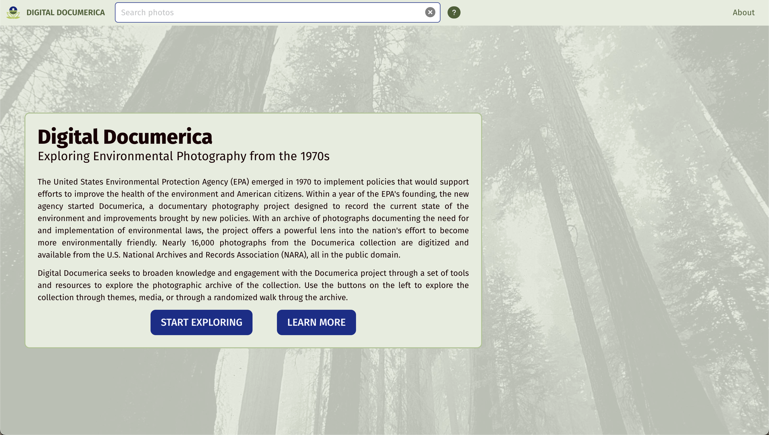
Digital Documerica
07 – Distant Viewing | Digital Documerica

Slide 33
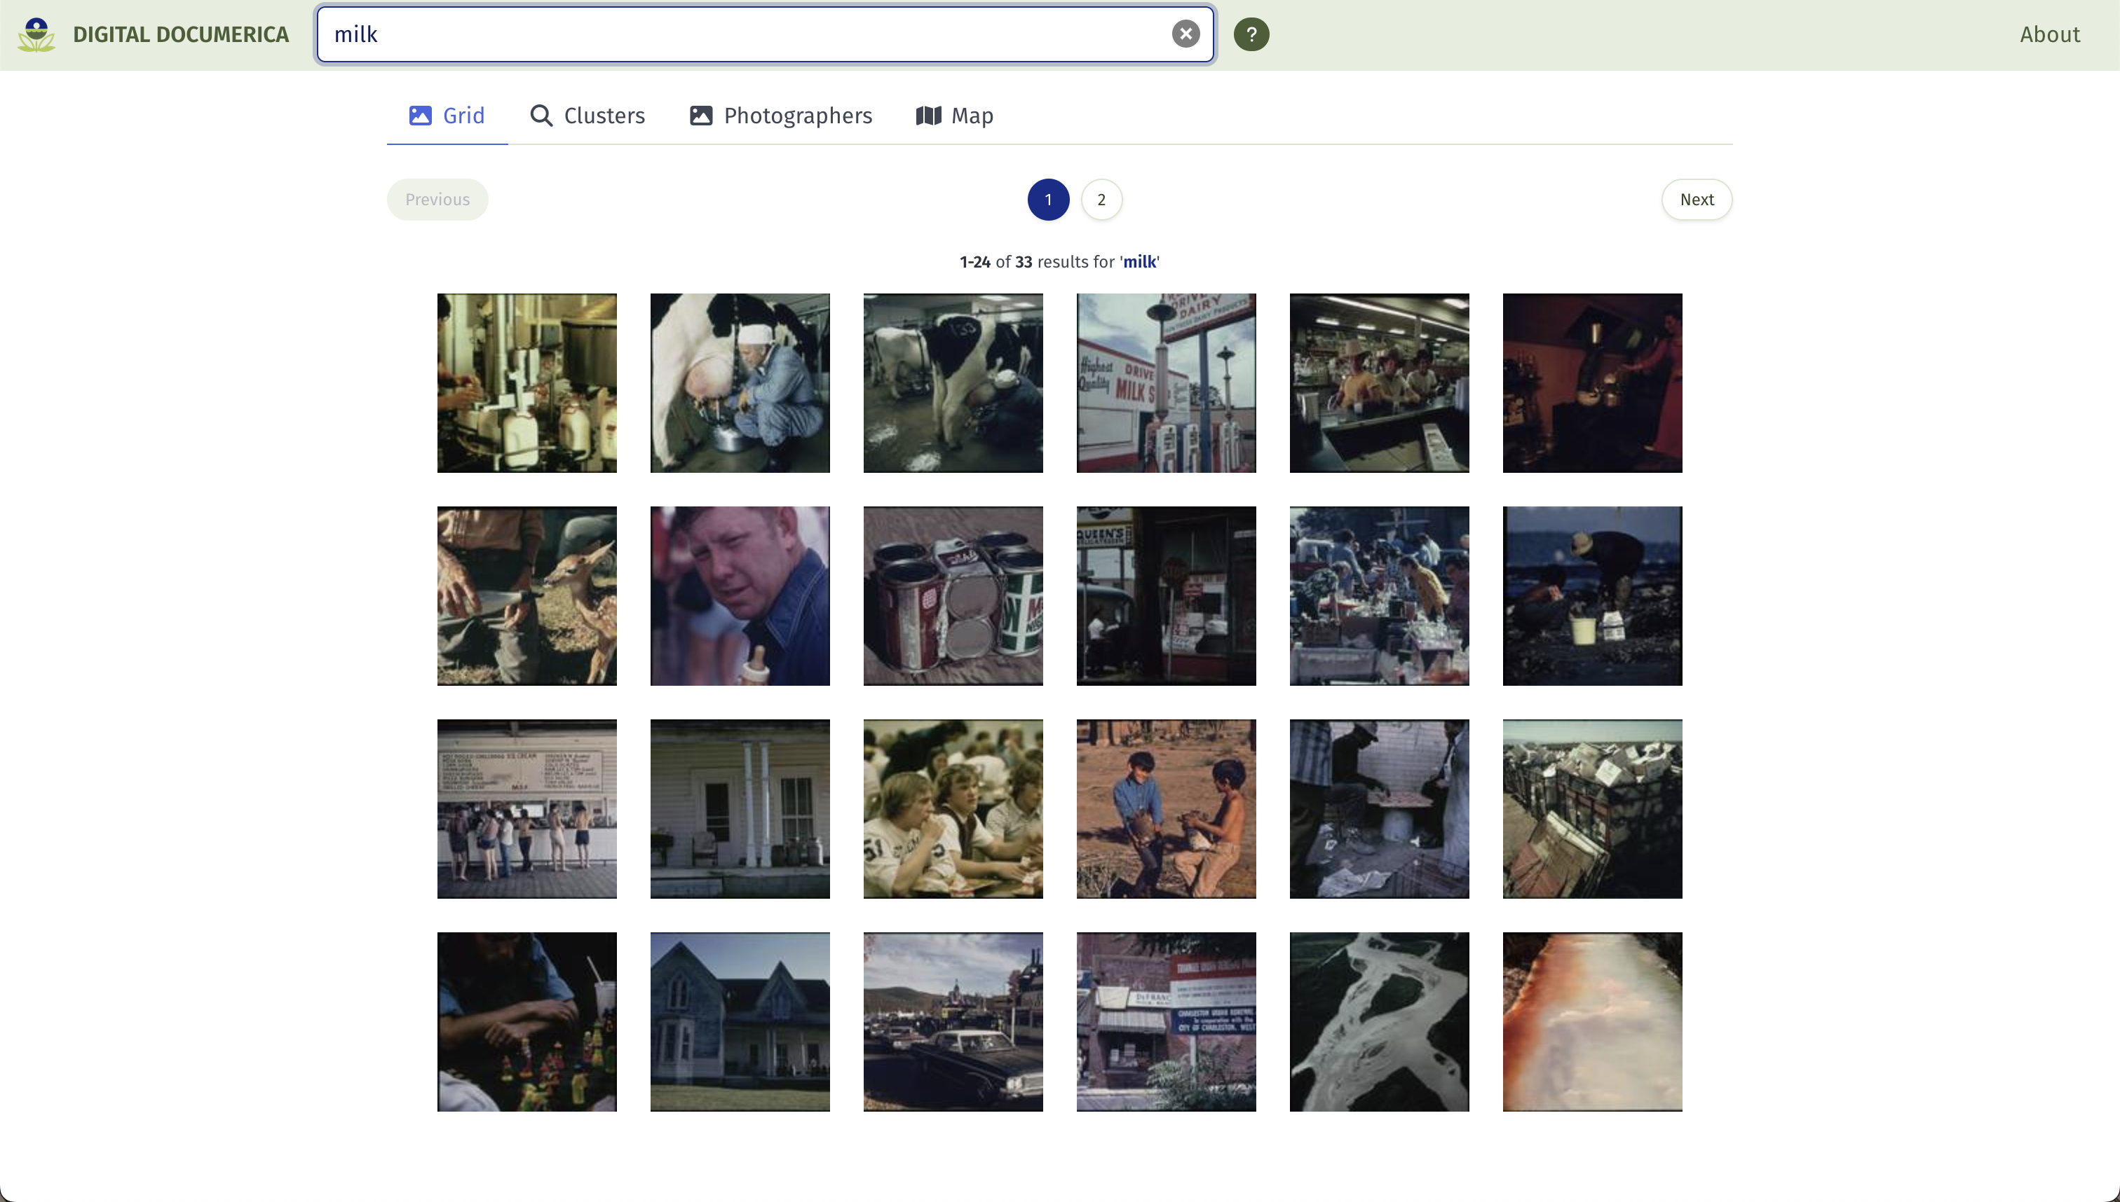
Digital Documerica
07 – Distant Viewing | Digital Documerica

Slide 34
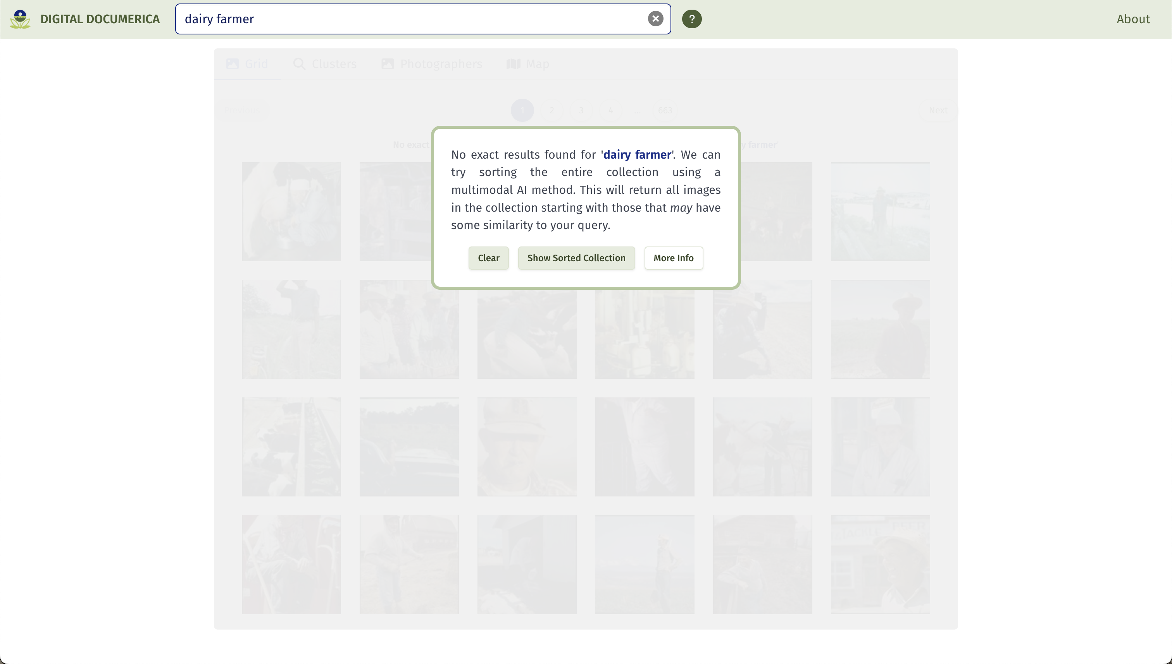
Digital Documerica
07 – Distant Viewing | Digital Documerica

Slide 35
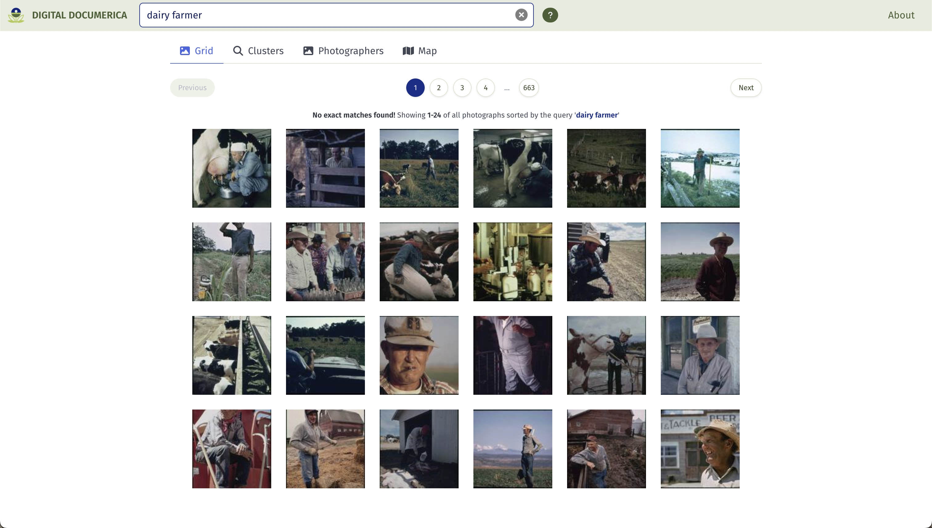
Digital Documerica
07 – Distant Viewing | Digital Documerica

Slide 36
8. Quantitative Evaluation
08 – Distant Viewing | Theory + MLLMs

Slide 37
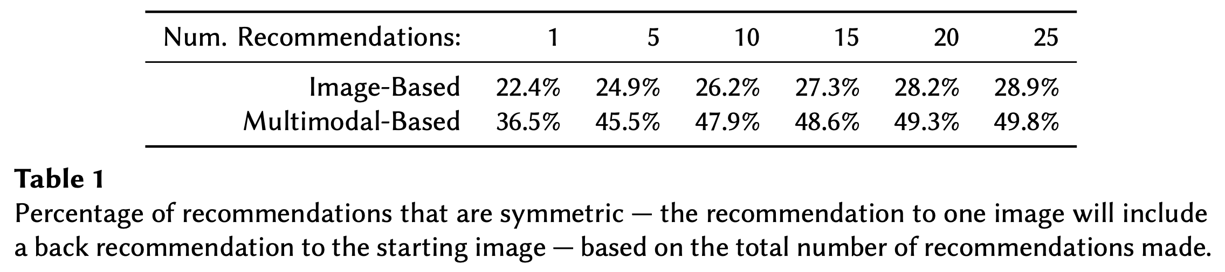

Symmetric Recommendations
In addition to the potential that we see from looking at a few example, it’s useful to also do some quantitative analysis of the results to compare the image-based and multimodal-based embeddings.
Here, we see the proportions of recommendations that are symmetric, seeing that the multimodal-based recommendations more consistently match in two dimensions. For 15-25 recommendations, the probability of having a symmetric link is about double that of the image-based method.
07 – Distant Viewing | Quantitative Evaluation

Slide 38
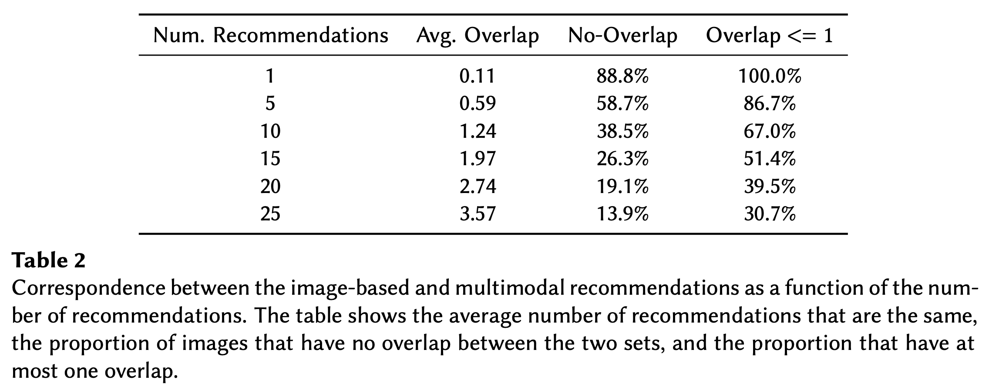
Comparing Image- and Multimodal-Embeddings
We can also see the overlap between the visual and multimodal recommendations. We would hope, and in fact see, that there is some overlap (good, because we know the visual recommendations do find interesting links) but that the multimodal approach mostly offers different links than those based on only images (indicating that this is an importantly different technique from previous methods).
07 – Distant Viewing | Quantitative Evaluation

Slide 39
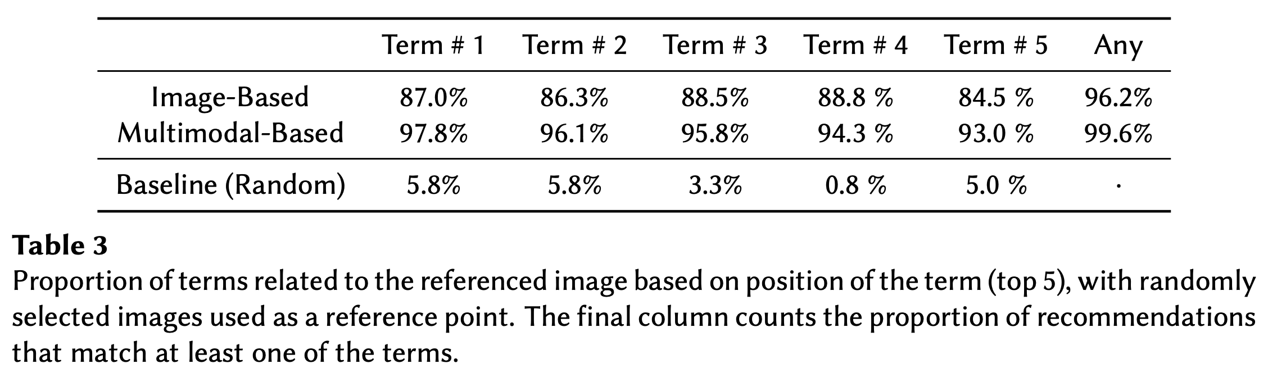
Explainable Recommendations
Finally, let’s see how much the tags associated with each of the sets of recommendations relates to the images. Here, we took a set of 100 recommendations and manually determined which links were valid.
We see that the the generated tags are useful for describing both image-based* and multimodal-based recommendations.
* The image-based tags use recommendations from the image embeddings but keywords from the multimodal model. These are not available with a visual-only approach.
07 – Distant Viewing | Quantitative Evaluation

Slide 40
9. Distant Viewing: Theory + MLLMs
09 – Distant Viewing | Theory + MLLMs

Slide 41
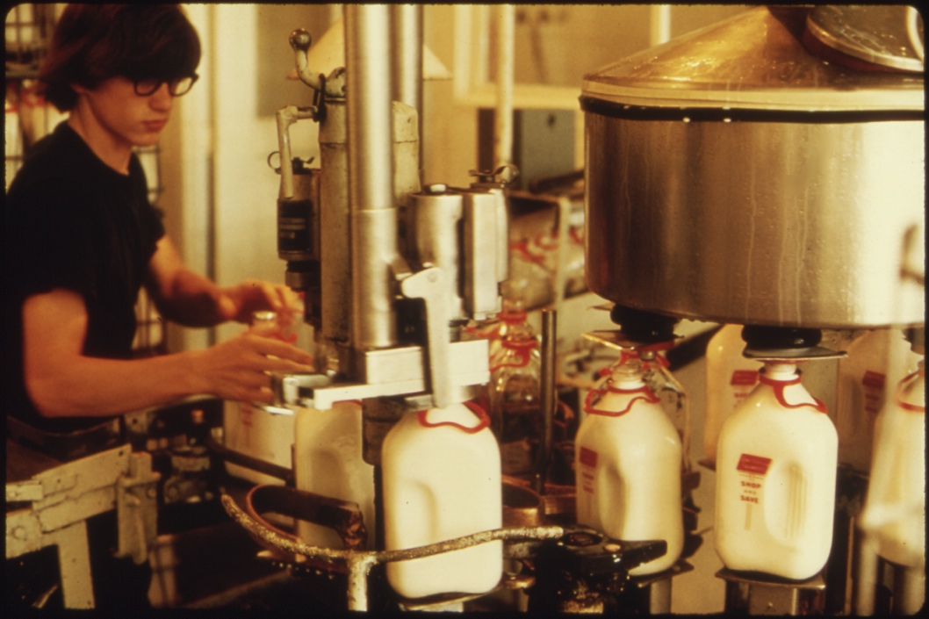
Distant Viewing: Theory + MLLMs
Flip Schulke, Employee of the Donald Dannheim Family who operate a dairy and ice cream store (July 1974).
The core ideas from the theory of distant viewing is that we need to create annotations to do computational analysis of digital images, that the creation of these annotations can be thought of as a digitally-mediated form of viewing at a distance, and that these forms of viewing at a distance are both subject and destructive.
MLLM model + prompt
This photograph captures a scene inside an industrial or agricultural processing facility, possibly a dairy. The image focuses on a female worker engaged in operating machinery used for filling milk bottles….
09 – Distant Viewing | Theory + MLLMs

Slide 42
Distant Viewing: Theory + MLLMs
Flip Schulke, Employee of the Donald Dannheim Family who operate a dairy and ice cream store (July 1974).
The core ideas from the theory of distant viewing is that we need to create annotations to do computational analysis of digital images, that the creation of these annotations can be thought of as a digitally-mediated form of viewing at a distance, and that these forms of viewing at a distance are both subject and destructive.
The potential power of MLLMs for working with collections of digital images further highlights each of these points. Turning images into textual descriptions is arguable closer to the way that we interpret images than previous types of computer vision annotations. Also, these new algorithms have a wide-open set of configurations and options through the choice of prompts and text filtering that accentuate how our decision making that influences the resulting output.
MLLM model + prompt
This photograph captures a scene inside an industrial or agricultural processing facility, possibly a dairy. The image focuses on a female worker engaged in operating machinery used for filling milk bottles….
09 – Distant Viewing | Theory + MLLMs

Slide 43
Distant Viewing: Theory + MLLMs
Flip Schulke, Employee of the Donald Dannheim Family who operate a dairy and ice cream store (July 1974).
The core ideas from the theory of distant viewing is that we need to create annotations to do computational analysis of digital images, that the creation of these annotations can be thought of as a digitally-mediated form of viewing at a distance, and that these forms of viewing at a distance are both subject and destructive.
The potential power of MLLMs for working with collections of digital images further highlights each of these points. Turning images into textual descriptions is arguable closer to the way that we interpret images than previous types of computer vision annotations. Also, these new algorithms have a wide-open set of configurations and options through the choice of prompts and text filtering that accentuate how our decision making that influences the resulting output.
In the era of large language models, understanding the implications of the theory of distant viewing is more important than ever.
MLLM model + prompt
This photograph captures a scene inside an industrial or agricultural processing facility, possibly a dairy. The image focuses on a female worker engaged in operating machinery used for filling milk bottles….
09 – Distant Viewing | Theory + MLLMs

Slide 44
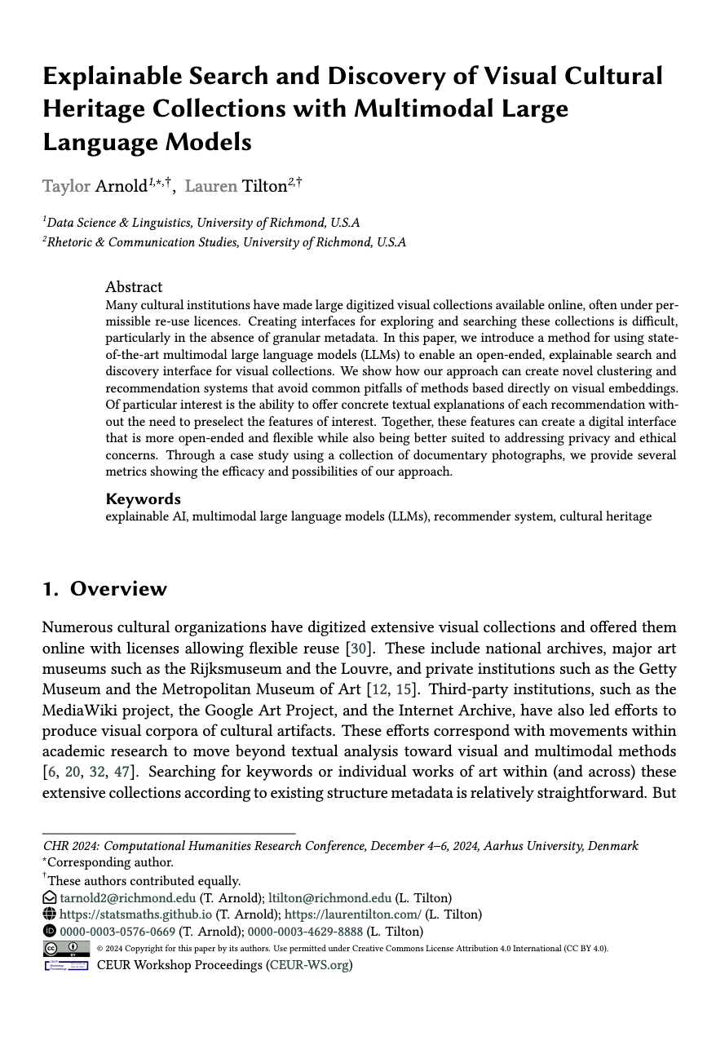
THANK YOU!
Please get in touch!
distantviewing.org
tarnold2@richmond.edu
https://digitialdocumerica.org

